Slide 1
Saving the Bits Programme Sally McInnes, Head of Unique Collections and Collection Care 2021
Notes:
Recap – looked at what is digital preservation and the OAIS model and the workflow that has been developed for Archivematica

Slide 2
Session 3: : Managing the transfer of digital content to the archive
Feedback from last session
Actions prior to transfer
Transfer actions
Transfer methods
Actions on receipt
Manual and automated accession workflows
Focus on metadata
Preparation for next session

Slide 3
Select sauce
Place in bag with checksums acquisistion data
Arrive at repository
Virus check
Copy with Teracopy and compare checksums
Run Fixity create checksums decide upon scheduling
Identify file formats with DROID
Create folders for data and metadata
Validate with JHOVE
Organise files with data and metadata
Acknowledge receipt and give reference number
The Path to True Data

Slide 4
Actions prior to transfer
Variety of data sources: individuals, organisations, harvesting, API specifications
Provide guidance for data management
Where possible, communicate with depositor/donator
Identify what you want to save and where it is
Name and organise files appropriately
Fill in metadata information
Save in recommended file formats
Back up regularly - cloud, external hard drives
Keep an eye on the hardware and software (remember the Siena!)
Ensure ant-virus software is up to date
Protect data
Notes:
Other tools available, including PRONOM

Slide 5
Transfer actions
Provide list of contents and description using the Digital Accessions form
Save in a structured way and delete unnecessary files
Save in recommended file formats
Complete deposit/donation form indicating ownership, rights, return of source
Avoid using protection measures

Slide 6
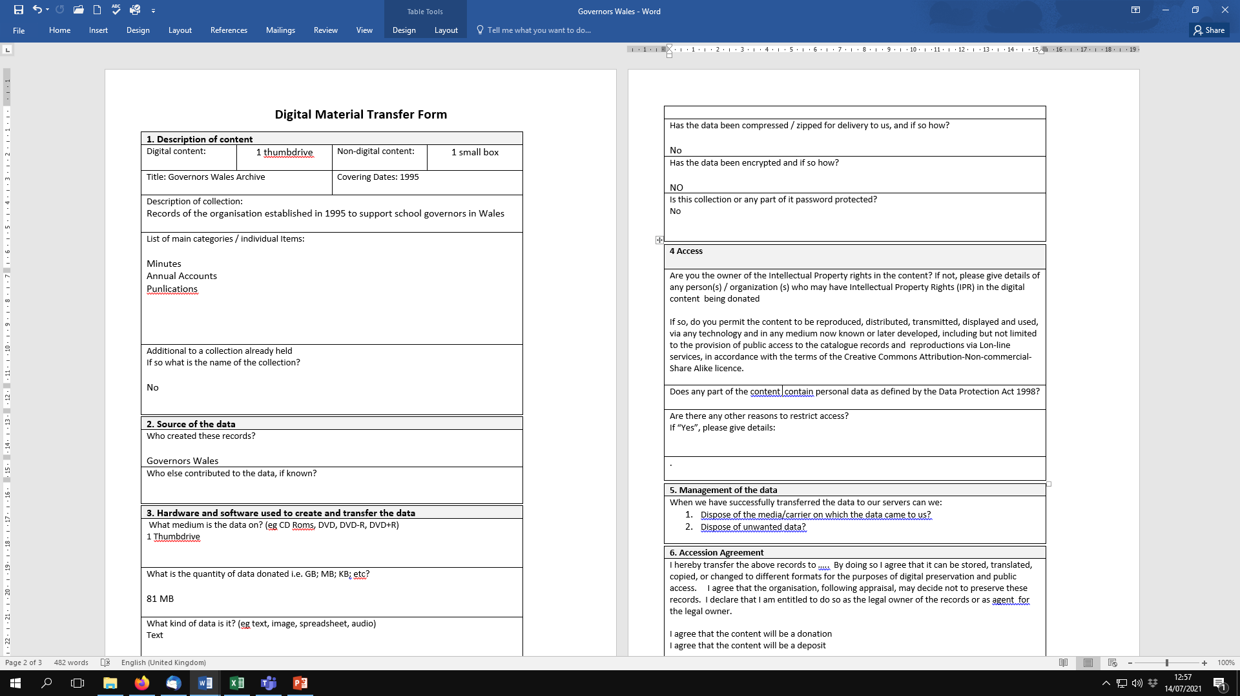
Digital Material Transfer Form
Notes:
Teracopy gives size and lists files

Slide 7
Transfer methods
Using Exactly which enables creation of Bag with metadata and Checksum
Hand held / portable media
Web Transfer/Dropbox
Email
API

Slide 8
Actions on receipt
Create directories for the content and the metadata
Virus check
Copy using Teracopy and checksums created by Teracopy to ensure that identical copies are made
Run through DROID to identify file format
Give a reference number/title to copied content
Export as CSV file and save as metadata file
Give metadata file related number to ensure linkage
Compare Teracopy and DROID checksums to ensure identical
Run fixity for monitoring and reporting on stored files: schedule reporting and lists contents
Validate with Jhove which gives summary of number of files and their types
Put the Digital Accession form in the metadata folder
Add the asset to the digital content audit form with identity information

Slide 9
Manual and Archivematica
Videos show the same process from the source to verification
Differences in process
Alma is library management system and all accessions provided with unique numbr

Slide 10
Spotlight on Metadata
Types of metadata
Descriptive: title, creator, date
Structural: how things relate to each other
Administrative: rights, preservation
Sources of metadata
Documentation created with transfer
Created automatically and embedded
Extracted by tools
Use of metadata
Intellectual control
Management and access
Preservation

Slide 11
Metadata standards
Dublin Core
Technical metadata standards – PREMIS
ISAD(G)
Identity
Context
Content
Access and Use
Allied materials
Notes
How much do you need and where to put it?

Slide 12
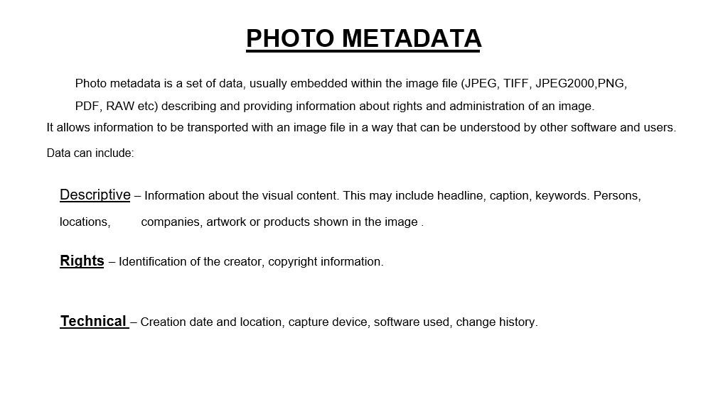
Metadata in photographs

Slide 13
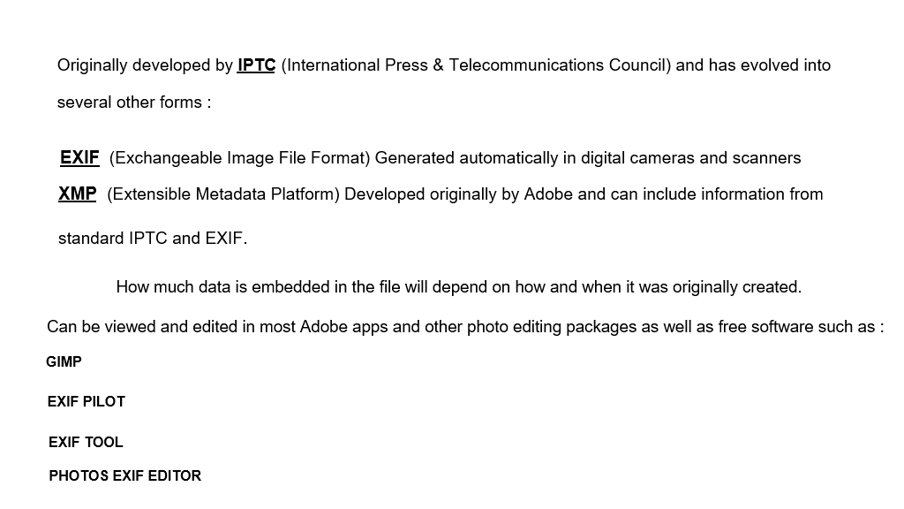
Embedded data

Slide 14
Preparation for next session
Consider metadata information required
Check that documentation is in place for transfer

