Slide 1
Saving the Bits Programme Sally McInnes, Head of Unique Collections and Collection Care 2021
Notes:
Hello and thank you for joining the Saving the Bits Programme. My name is Sally McInnes and I am Head of Unique Collections and Collections Care at the Library. Over the next few weeks, we will share knowledge, experience of digital preservation. It is intended that this is a practical course, rather than theoretical. It is not intended to cover issues such as creating a business case for digital preservation, but hope that the information which it shares will help you to do this and to advocate for the need for digital preservation.

Slide 2
Session 4: Managing content
Review of previous sessions
Managing transferred content
Elements of the Archival Information Package
Video providing examples of issues
Preservation planning case study: Unlocking Our Sound Heritage Project

Slide 3
Recap of previous sessions
Session 1: RAM and NDSA Levels of Preservation
Session 2: Preparation: workstation, software, audit template
Session 3: Managing records for transfer
Session 4: Managing content after transfer and case study on preservation planning for sound material

Slide 4
Managing content after transfer
Steps to managing content : analysis of metadata, verification and validation, decide which formats to use for preservation and access
Creation of Archival Information Package: complete set of files that have all the qualities needed for preservation
Preservation planning: underpins on-going access and preservation

Slide 5
Elements of the Archival Information Package
Data has been virus checked and run through JHOVE
Folder created containing source data
Folder created with metadata, including checksums, JHOVE reports
Analysis of metadata: checking the reports for issues and correction, corrupt files, encrypted files
Discussion with depositor/donator if issue with data or rights information
Decision on creating preservation/access copies according to policy
Description of content (full cataloguing may be done later)
Access restrictions applied

Slide 6
Archival Information Package
Includes all the qualities that are required for long term preservation
Source data, metadata and rights information and checksums
Preservation and access formats created
Descriptive information created

Slide 7
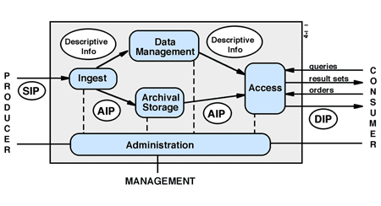
OAIS model

