Slide 1
Saving the Bits Programme
Sally McInnes, Head of Unique and Contemporary Content
2021

Slide 2
Session 6: Access
Access Essentials
Methods of access to content
Born digital levels
Video: methods of access, creation of access copies, restricted access
IIIF and crowdsourcing platform
Feedback and next steps

Slide 3
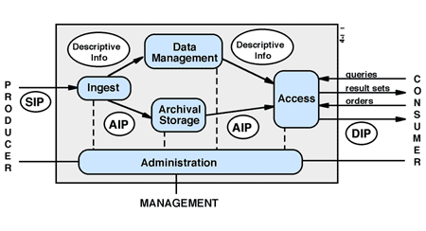

OAIS model

Slide 4
Access Essentials
Policy
  Pre-accession: documentation including technical and content information, rights information,
  Decisions on access format: Word to Pdf, Image to JP2, audio-visual MP4
  Decisions on rendering: onsite/remote access/platform
  Security: virus checking, infrastructure resilience
  Technology
  Onsite access: standalone workstation with tools
  Digital access: ways to render
  Access methods
  Catalogue
  Discovery platforms

Slide 5
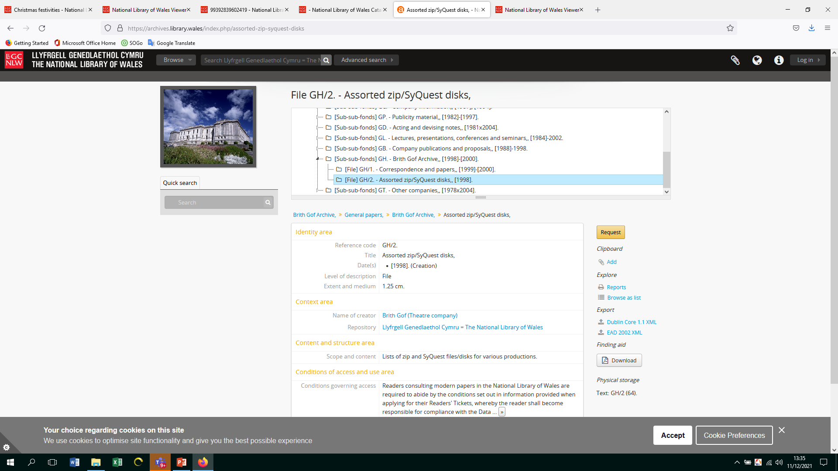
Access: standalone machine

Slide 6
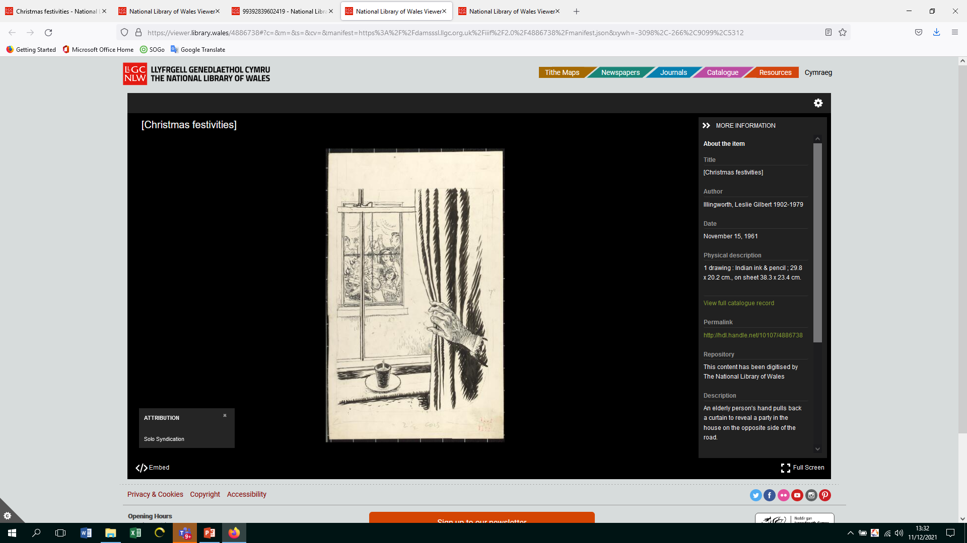
Access: from catalogue to viewer
Notes:
The catalogue search provides a link to view online. The viewer provides information: an elderly person’s had pulls back a curtain to reveal a party on the other side of the road and link to rights statement

Slide 7
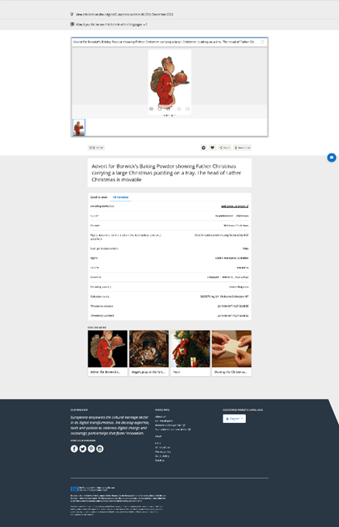
Third party: Europeana
Notes:
Advert for Borwick’s baking powder showing Father Christmas carrying a large Xmas pudding on a tray. The head of father Christmas is movable license CCBy 4.0 which means that it can be shared, remixed, but credit should be given and no

Slide 8
Digital Library Federation: Levels of Born Digital Access
Three Levels of Born-Digital Access
  Accessibility
  Description
  Researcher Support and Delivery
  Security
  Tools

Slide 9
Level 1
Information concerning the born digital content, such as collection level description
Enable basic access to and duplication of content
Use of virus free content on a standalone public access terminal with security measures
Tools available to render widely used file formats, e.g Adobe Acrobat, MS Office

Slide 10
Level 2
Access to information and metadata
Descriptive information for multi-level records and notes
Create and provide access to technical documentation and support available from staff. Get user feedback
Provide secure remote access to open content, respecting access polices
Tools to support enhanced access, software to support investigation of files

Slide 11
Level 3
Users can render/use content
Provide access to metadata which describes and documents action. Provide direct links to digital content
Provide additional technical guidance for emulation and content analysis. Develop new services
Create access controls to support secure onsite and remote access to conditionally restricted content, using redaction and encryption. Undertake audits
Provide tools for exploring, rendering and interpretation. Provide hardware and software to support legacy content, including emulation software

Slide 12
Feedback and next steps
Vicky to ask for feedback on sessions
Areas missed/additional sessions
Sharing knowledge and experience

